Slide 1

Dr.Mahalingam College of Engineering & Technology
Department of Computer Science and Engineering 19CSPN6401 & Mini - Project
Final Review
Title : IOT BASED MOBILE APPLICATION FOR GARBAGE MONTORING SYSTEM
Domain: Internet of Things
Team Number: 05
Team Member(s): DHARANISH S - 727621BCS020
KARTHICK RAM S - 727621BCS022
HARIHARAN V - 727621BCS040
Faculty Supervisor: Ms.R.Bharathi AP/CSE
Date: 19.05.2023

Slide 2
Contents
Domain Introduction
Problem description/Statement
Abstract
Objective of the Project
Block diagram for existing system
Literature Survey

Slide 3
Contents
Hardware / Software Requirements
Block Diagram
Components used Reference(s) Online course details Progress / Completion

Slide 4
Domain Introduction
The Internet Of Things(IOT) is an ecosystem of connected devices that communicate and exchange data with each other.
In this project , we are going to monitor garbage level in garbage bins by using ultrasonic sensors placed over the bins to detect the garbage level and compare it with the garbage bins depth to detect the garbage level.
This project IOT Garbage Monitoring system is a very innovative system which will help to keep the cities clean.
This system used to display the status of the level of garbage collected in the bins.

Slide 5
Problem description
A big challenge in the urban cities is solid waste management.
The garbage collecting authority in traditional waste management system doesn’t know about the level of garbage in dustbin, if the dust bins gets full by garbage then it gets overflowed as well as spelled out from the dustbin leading to unhygienic condition in cities.
People throw garbage on that dustbin which is already overflowed.
People those who work in this garbage collection job are totally disappointed by the residents improper waste management scenario.
Sometimes due to unclean garbage bins bad smell arises also toxic and unhygienic gases are produced which is way to support to the air pollution and to some harmful diseases which are easily spreadable.

Slide 6
Abstract
In Garbage Monitoring System tells that whether the trash can is empty or full through the webserver and can know the status of the ‘Trash Can’ or 'Dumpsters' from anywhere in the world over the Internet.
In this IOT Project, an Ultrasonic Sensor is used for detecting whether the trash can is filled with garbage or not.
Ultrasonic Sensor is installed at the top of Trash Can and will measure the distance of garbage from the top of Trash can and set a threshold value according to the size of trash can.
If the distance will be less than this threshold value, means that the Trash can is full of garbage and the message “Basket is Full” is displayed.

Slide 7
Objective
The main objective of this project is to maintain the level of cleanliness in the city and form a environment which is better for living.
By using this system we can constantly check the level of garbage in the dustbins which are placed in various parts of city.
The real-time information can be gained regarding the level of the dustbin filled on the system itself. It will also help in reducing the cost as the employees will have to go only at that time when the bin is full.
This will also help in resource optimization and if the bins will be emptied at time then the environment will remain safe and free from all kinds of diseases.

Slide 8
Block diagram for existing system
Blynk server
Power Supply
Arduino UNO
(Microcontoller)
Blynk app
Ultrasonic
Sensor
ESP8266(WiFi-Module)

Slide 9
Literature survey
S.No | Title of the paper &year | Author | Protocol/ Sensors used | Merits | Demerits
1 | Smart Garbage Monitoring System Using Internet of Things (IoT)-2018 | P. Kavitha and S. Gopalakrishnan | Micro Controller, LED | can enhance the dustbin level information | Technical Issues such as poor connectivity
2 | Design and Implementation of a Smart Garbage Monitoring System Using Wireless Sensor Networks-2019 | S. Das | LCD, IR Sensor | Easy to monitor level of garbage | Limited Range, Cost
3 | Smart Waste Management System Based on IoT-2020 | S. Jain and M. D. Agrawal | Micro Controller, IR Sensor, LED, LCD | Low cost and accessible solution for garbage monitoring | Couldn’t provide the proper implementation

Slide 10
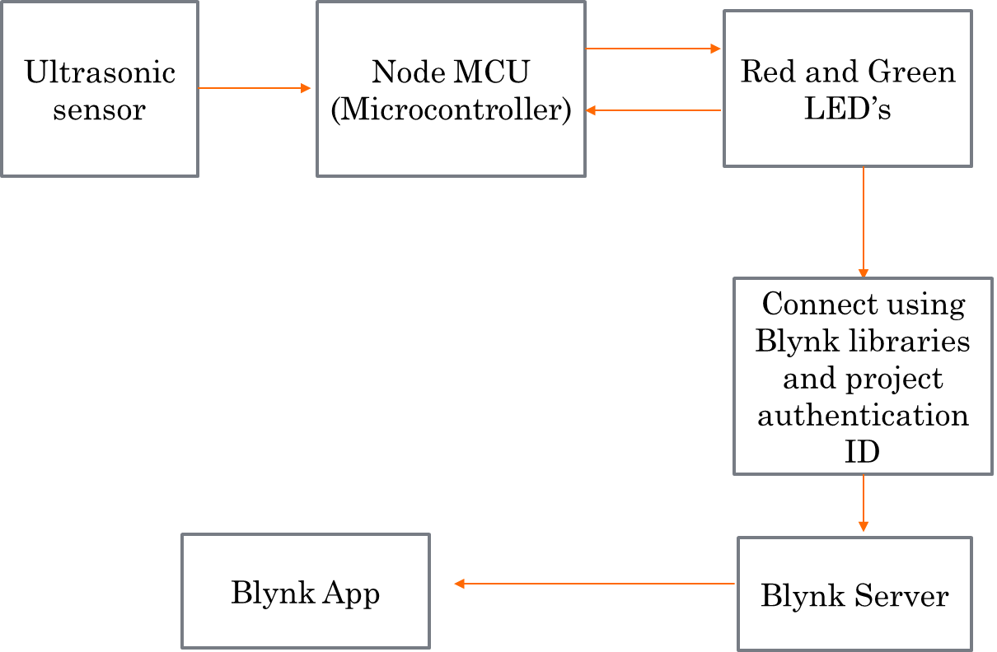
Block diagram
.

Slide 11
Hardware / Software Requirements
Hardware Requirements:
Node MCU
Ultra Sonic Sensor
LED
Resistors
Software Requirements:
Blynk app
Arduino IDE

Slide 12
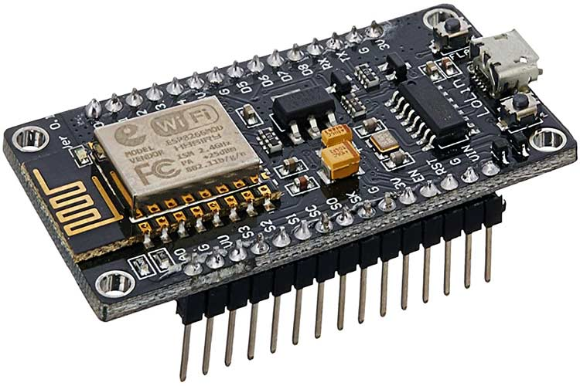
Components Used
NodeMCU ESP8266
NodeMCU is an open-source Lua based firmware and development board specially targeted for IoT based Applications. It includes firmware that runs on the ESP8266 Wi-Fi SoC from Espressif Systems, and hardware which is based on the ESP-12 module.
The NodeMCU ESP8266 development board comes with the ESP-12E module containing the ESP8266 chip having Tensilica Xtensa 32-bit LX106 RISC microprocessor.

Slide 13
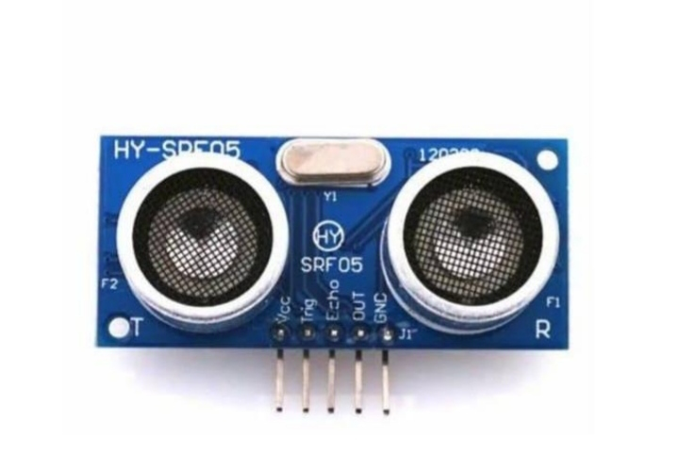
Components Used
Ultrasonic Sensor
• Ultrasonic Sensor can measure the distance to a wide range of objects
regardless of shape, color or , surface texture
• Ultrasonic Sensor emit short, high-frequency sound pulses at regular
intervals.These propagate in the air at the velocity of sound.

Slide 14
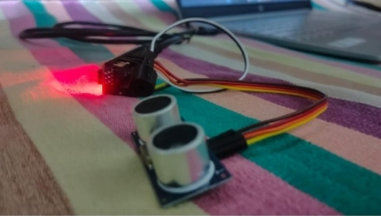
Module(Ultrasonic Sensor)

Slide 15

Components Used
A light-emitting diode (LED) is a Semiconductor device that emits the light when current flows through it. Electrons in the semiconductor recombine with electron holes, releasing energy in the form of photons.
The color of the light (corresponding to the energy of the photons) is determined by the energy required for electrons to cross the band gap of the semiconductor

Slide 16
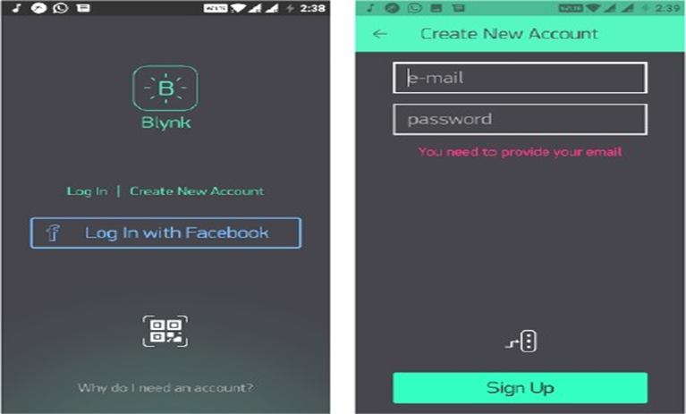
Software Used
BYLNK APP
To connect to the internet we make use of a prebuilt platform called Blynk app. After the user installs the Blynk app on the smartphone, an account to be created in the app to access its services. The services are enabled for the signed users. Let us create an account and add a new project to get started. An unique authentication code is used by the code to communicate with the project. The Blynk needs to be running in the background for the user to get real time notifications

Slide 17
Languages Used
Embedded C:
Embedded C is an extension of C language and it is used to develop micro-
controller based applications. The extensions in the Embedded C language from
normal C Programming Language is the I/O Hardware Addressing, fixed-point
arithmetic operations, accessing address spaces, etc.

Slide 18
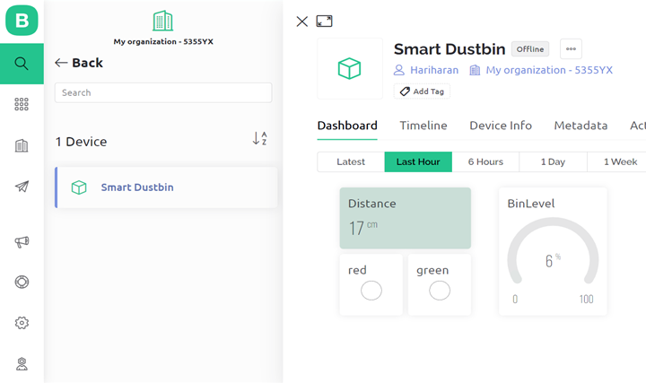
Implementation
The figure represents the web dash board data for garbage monitoring system

Slide 19
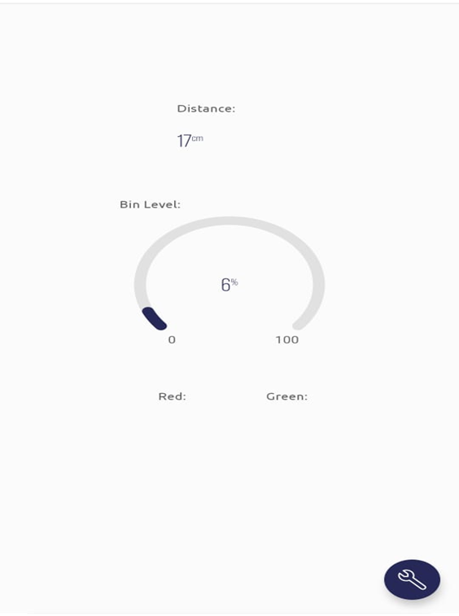
Implementation
The figure represents the garbage level using garbage monitoring system.

Slide 20
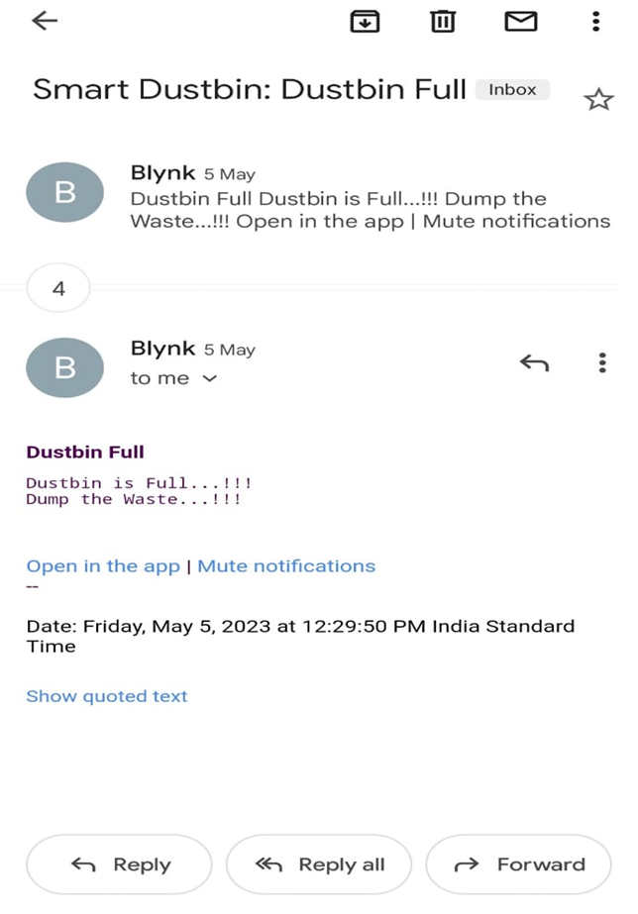
Implementation
The figure represents gmail alert when the garbage is full

Slide 21
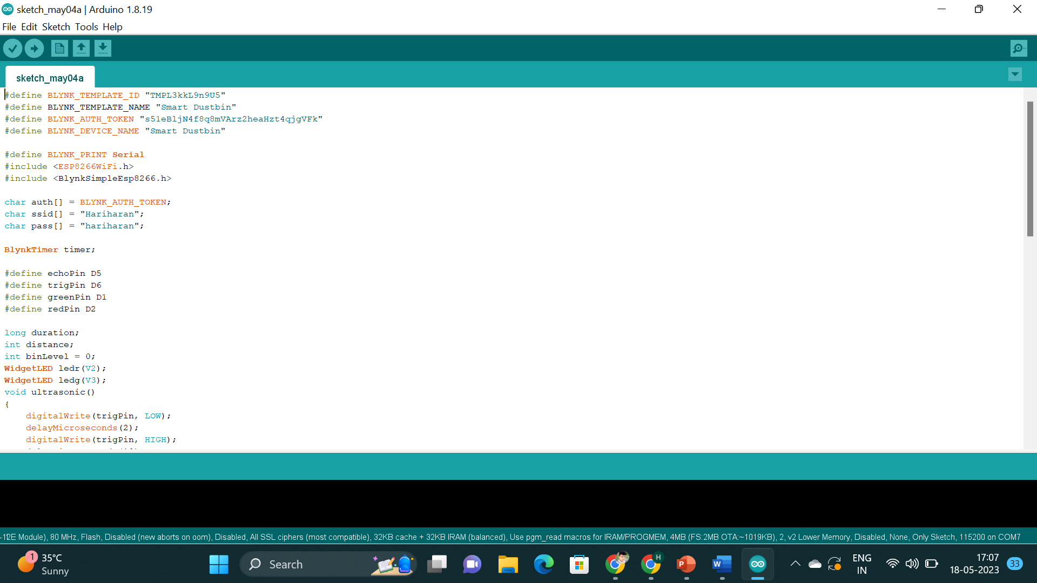
Implementation

Slide 22
References
"Smart Garbage Monitoring System Using Internet of Things (IoT)" by P. Kavitha and S. Gopalakrishnan (2018)
"Design and Implementation of a Smart Garbage Monitoring System Using Wireless Sensor Networks" by S. Das and S. Das (2019)
"Smart Waste Management System Based on IoT" by S. Jain and M. D. Agrawal (2020)
"Real-Time Garbage Monitoring System for Smart Cities using IoT" by P. Singh and P. Kumar (2021)
"Garbage Management System Using IoT and Machine Learning" by S. Aggarwal and R. Sharma (2021)

Slide 23
Website link
https://www.geeksforgeeks.org/iot-and-garbage-monitoring-system/
https://electronics-project-hub.com/iot-based-garbage-monitoring-system/
https://www.academia.edu/37968385/IRJET-_SMART_GARBAGE_MONITORING_SYSTEM_USING_IOT

